Slide 1
50.003: Elements of Software Construction
Week 2
Introduction to Software Design

Slide 2
Plan for the Week
Class 1: Guess Lectures
By game lab experts
By your seniors
Class 2:Software Design Documentation
UML: Use Case Diagrams
UML: Sequence Diagrams
Class 3:
UML: Class Diagrams
UML: State Machine Diagrams

Slide 3

Software Design
User Requirements
How do we design it such that we can implement a system which fulfills the requirements?
System Implementation

Slide 4
What is software design?

Slide 5
What is Design?
choice 1
Design Space
choice 2
choice 3
choice 4
choice 5
choice 6
choice 7
choice 8
choice 9
Good Designs
ch. A
ch. B
ch. C
ch. D
ch. E
ch. F
ch. G

Slide 6
The Rational Model
Input: Goal, Desiderata, Utility function, Constraints, Design tree of decisions
Until (“good enough”) or (time runs out) {
Do another design (to improve utility function)
Until design is complete
Backtrack up design tree
Explore a path not searched before While design remains feasible,
make another design decision
EndWhile
EndUntil
EndDo
Take best design
EndUntil

Slide 7
Software Design is Hard
For software systems, we don’t exactly know the user requirements.
“A chief service of a designer is helping clients discover what they want designed.”

Slide 8
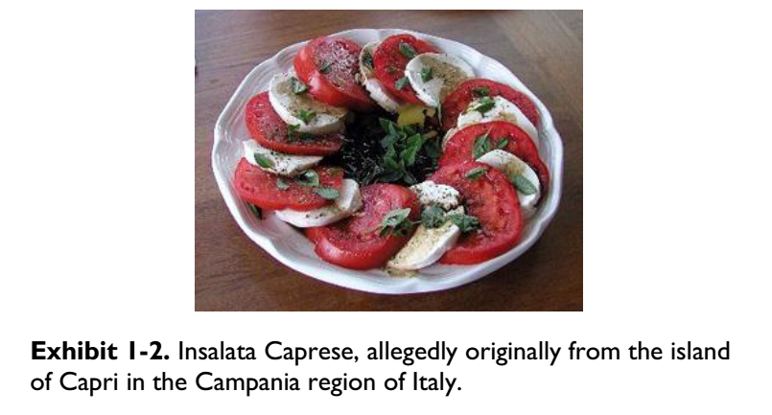
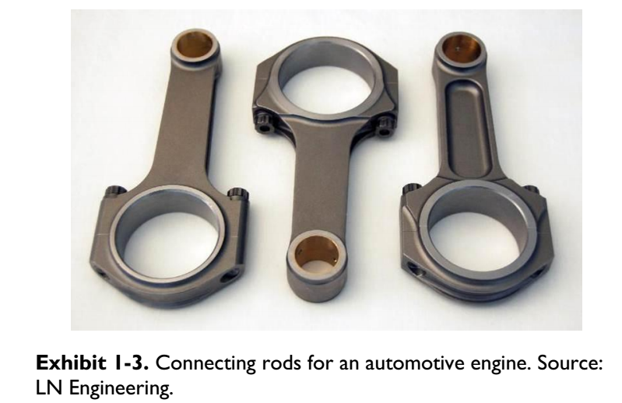
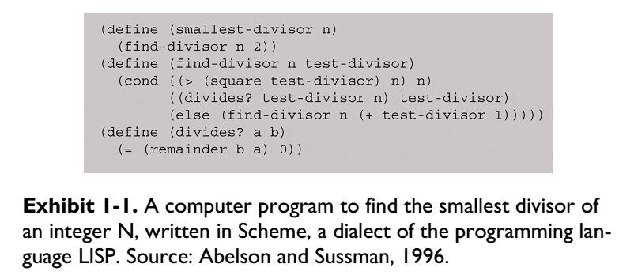


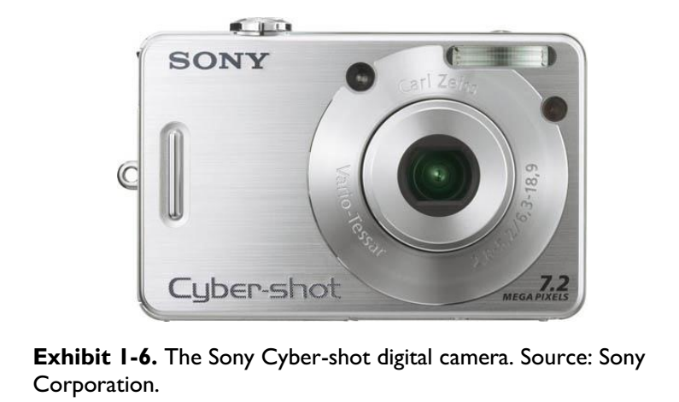
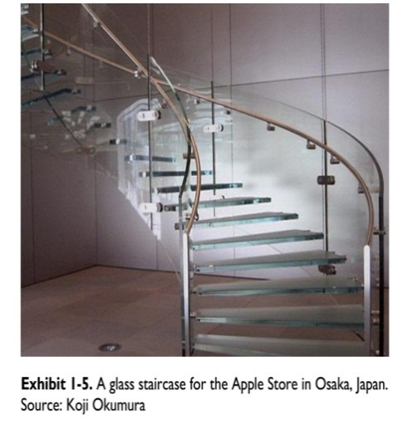

Slide 9
Software Design is Hard (cont’d)
Even if the user requirements are clear, we wouldn’t know all the design choices.
Experienced designers do better design because
They know better about the design choices.
They know better about the relations between the choices.

Slide 10
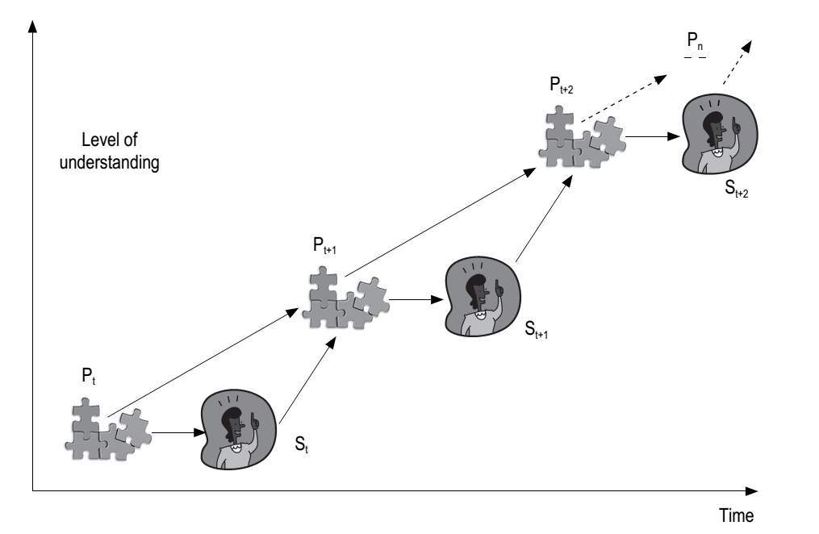
Criticizing the Rational Model

Slide 11
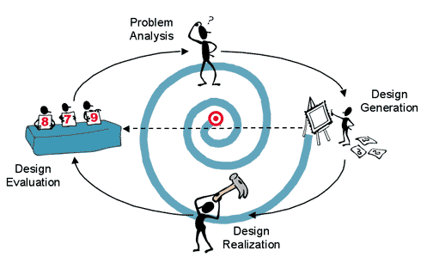
Is this similar to certain software development process?

Slide 12
Software Design is Hard (cont’d)
Even if we know all the design choices, the combinations of design choices are exponential and therefore it may not be easy to find a good design.

Slide 13



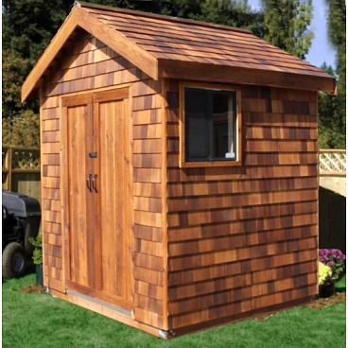

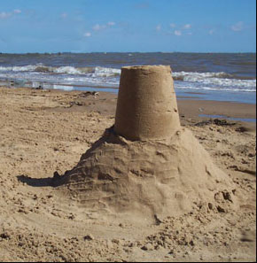
COMBINATORIAL COMPLEXITY

Slide 14
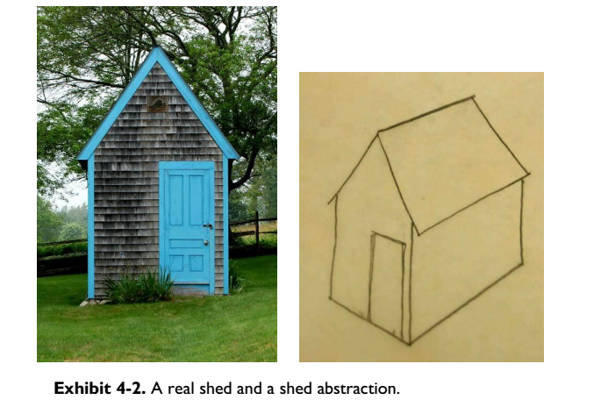

Slide 15
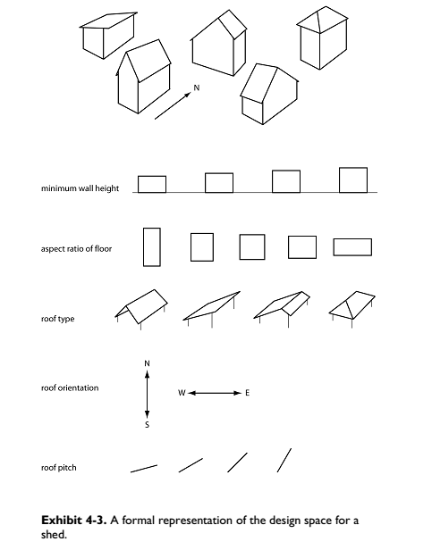

Slide 16
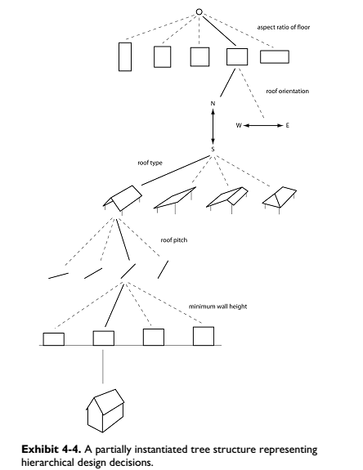

Slide 17
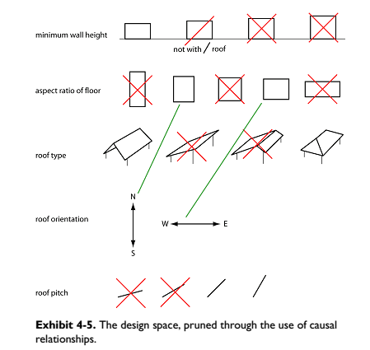

Slide 18
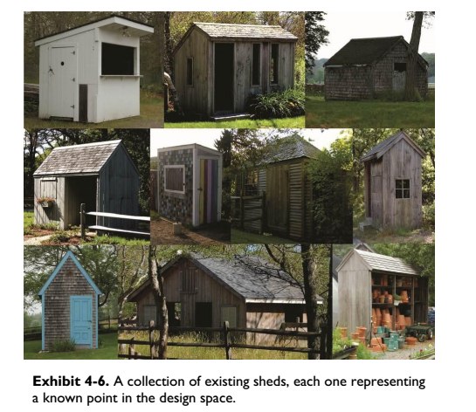

Slide 19
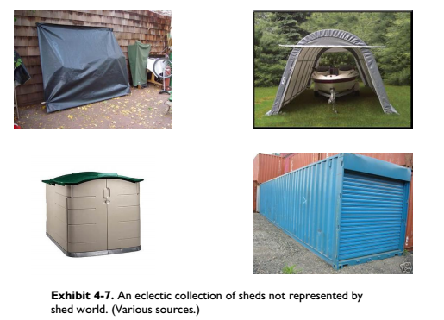

Slide 20
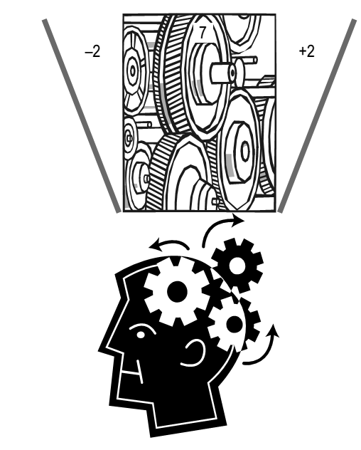
ADDRESSING COMPLEXITY IN DESIGN
Miller’s Law

Slide 21
Cohort Exercise 1 (15 min)
Write a function which takes three numbers and return the second largest one.
Write a function which takes four numbers and return the second largest one.

Slide 22
Strategies for addressing complexity
Decomposition
Abstraction
Hierarchy

Slide 23
Decomposition
Divide et impera (divide and rule) is a technique of mastering complexity in vogue since ancient times [Dijkstra 1979].
Key idea:
Break down a system into smaller and more manageable parts, so that the channel capacity of our comprehension is not breached.

Slide 24
Abstraction
One of the most frequently used words in the context of software design
Key idea:
Unable to master the entirety of a complex object, we choose to ignore its inessential details, dealing instead with the generalized, idealized model of the object [Booch et al. 2007].

Slide 25
Hierarchy
Whenever we examine something new or something that seems to be complex, we try to see what common characteristic it shares with other things we know, or if it is part of something we have seen earlier.
Key idea:
“Is a” relation: E.g. a car is a locomotion device with wheels
“Part of” relation: A part of a car is the engine

Slide 26
Cohort Exercise 2 (25 min)
Design and implement a program that supports accepting two complex numbers from the user; adding, subtracting, multiplying, and/dividing them; and reporting each result to the user.

Slide 27
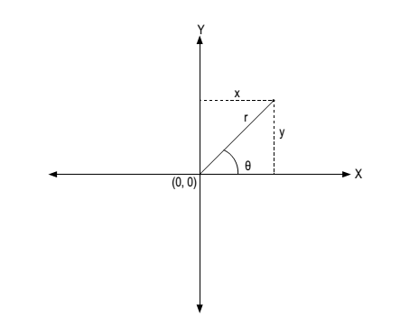
Cohort Exercise 3 (cont’d 10 min)
Support complex numbers in both rectangular form and polar form.

Slide 28

Further Reading
Parnas, David L., (December 1972). “On the Criteria to be Used in Decomposing Systems into Modules". Communications of the ACM. Volume 15, Number 12, pages 1053-1058
http://tinyurl.com/2cf9lx6

Slide 29
The Languages of software development

Slide 30
The Spectrum of Languages
Languages for implementation:
programming languages: precise and executable but perhaps not a good media for communication
Languages for software development process:
modelling languages: often visual, often not executable, high-level, aiming for communication between different parties in software development processes
Languages for user requirements:
Structured English: not visual, not executable, not precise, extremely flexible

Slide 31
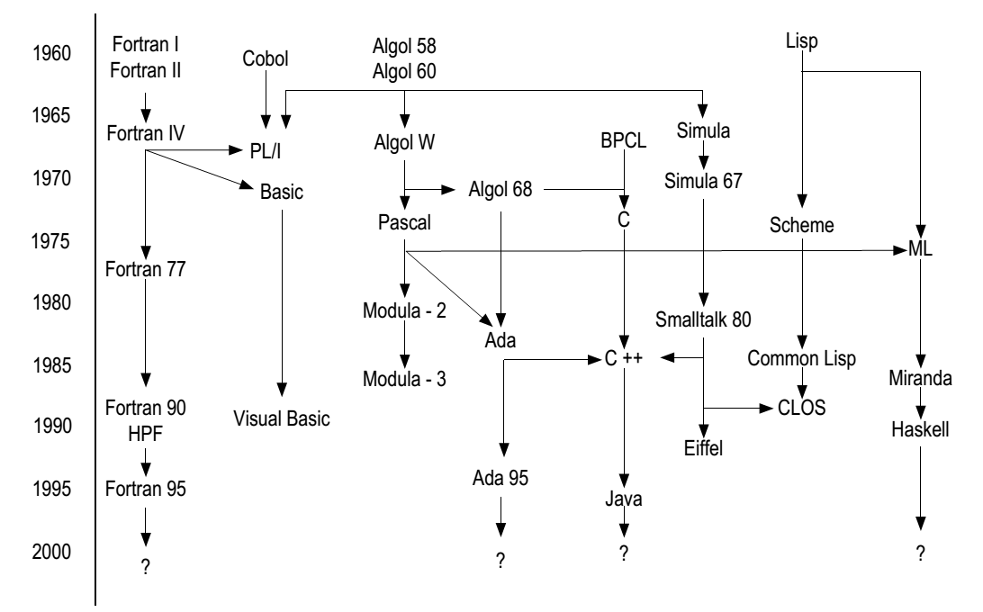
Lineage of programming languages
Check this out: http://www.levenez.com/lang/lang_a4.pdf

Slide 32
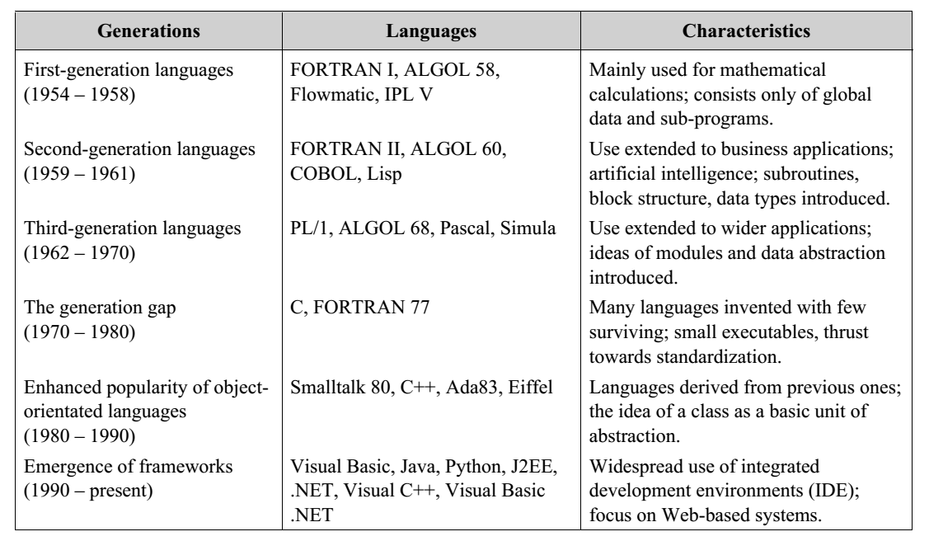
Generations of PL

Slide 33
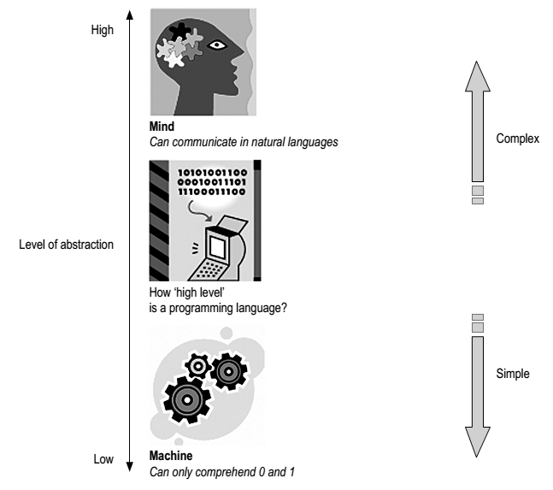
The High and Low of PL

Slide 34
Why Modeling Languages?
Modeling languages are mainly for documentation and communication.
Documentation is an important part of software engineering.
Documentation is perhaps a part of any software development process.
It forms the basis of an iterative design process.
It forms the basis of effective communication among three parties, through time.
There are formal modeling languages and informal ones.

Slide 35
Unified Modelling Language
UML is a visual language that lets you model processes, software, and systems.
UML is made up of notation and diagrams
Notation consists of the elements that work together in a diagram, such as symbols, connectors, notes, values, etc.
Diagrams are pictorial representation of a process, the system, or some part of.
UML is defined as a set of specifications created and distributed by the Object Management Group (OMG).

Slide 36
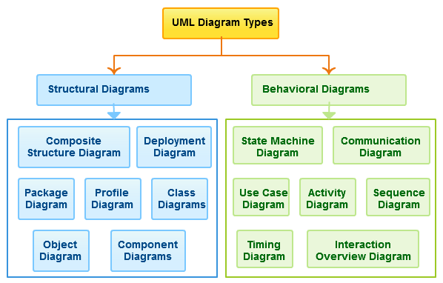
Unified Modelling Language
UML is extensible.
There are 14 UML diagram types.
UML is flexible.

Slide 37
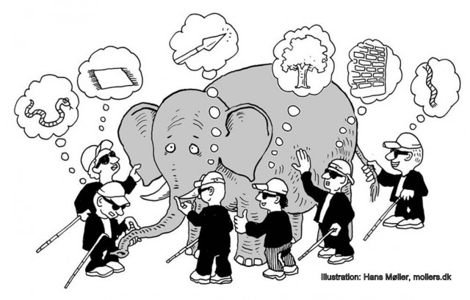
Why so many diagrams?
http://mappingignorance.org/2013/07/25/selective-ignorance-in-science/

Slide 38
We Will Cover
Use Case Diagrams
Sequence Diagrams
Class Diagrams
State Diagrams

Slide 39
User Requirements: a Case Study
Preeti is leading a team of software engineers engaged in building the system. Kuber Bank (KB) has been in the banking business for over thirty years with branches all over India. About 15 years ago, the branches were computerized and they are currently connected through a nation-wide network. To keep up with the competition, KB needs to offer online banking facilities to its customers. Preeti’s organization has won the contract to ‘Webify’ KB. An initial meeting was arranged between KB’s senior management and Preeti’s team to understand the scope of the projects.
- ‘So, as a first step, it would be good for us to know the broad requirements you have in mind’, began Preeti.
- ‘Well, we want to let the customers do online all they can do at a branch’, Sanjeev Kumar, KB’s senior vice-president, replied.

Slide 40
Roles and Functionality
Administrator can:
View transactions across all accounts
Add transactions to any account
Delete transactions from any account
Review all messages sent by users
Reply to messages sent by users
User can:
View their profile information
View list of their accounts with the bank
View transactions for each of their accounts
Send messages to the bank
View history of messages they have sent to the bank and replies from the bank

Slide 41
Contracting: Glossary
Account: the bank account held by a user with Kuber Bank (KB), identified by a unique account number
Administrator: A special type of user who has unique privileges in manipulating information relevant to KBO.
KBO: the Kuber Bank Online system
User: An account holder of KB who is allowed by KB to use KBO
…
Can the Administrator be an User too?

Slide 42
Contracting: Requirement Description
KBO_Req_01: Recording Transaction Details in KBO by administrator
Administrator shall access transaction information of a particular account on a periodic basis and record the same in the KBO system such that user can view them through the Web interface. The transaction information will be available to be accessed by the administrator in the existing Master Ledger (ML) system. Details for a transaction need to be available at KBO for viewing by a user within 48 hours after the transaction have been initiated by the user.
Is this good enough?

Slide 43
Description of Requirements
KBO_Req_01 Expanded
Administrator shall manually access transaction information for a particular account on a periodic basis from the existing Master Ledger system. (Automation of this access mechanism is outside the scope of KBO’s current release and may become a Requirement for a future release.) Administrator shall record the transaction information for a particular account accessed from the ML system, in the KBO system. Only successful transactions need to be available at KBO for viewing by users within 48 users after they have been initiated by the user. Users will be notified of failed transactions through procedures outside the scope of KBO’s current release.

Slide 44
Description of Requirements
KBO_Req_01: Non-functional Parts
Ensuring transactions are recorded in a format that makes it reasonably easy to be understood by users.
Ensuring transactions are correctly recorded for the appropriate user accounts.
Ensuring successful transactions are recorded at KBO within 48 hours of their initiation.
Ensuring large volumes of transaction for a particular account within a particular period of time can be handled.

Slide 45
Use Case
“To my knowledge, no other software engineering language construct as significant as use cases has been adopted so quickly and so widely among practitioners. I believe this is because use cases play a role in so many different aspects of software engineering.”
Ivar Jacobson
Founding father of UML
Creator of Use Case Diagram

Slide 46
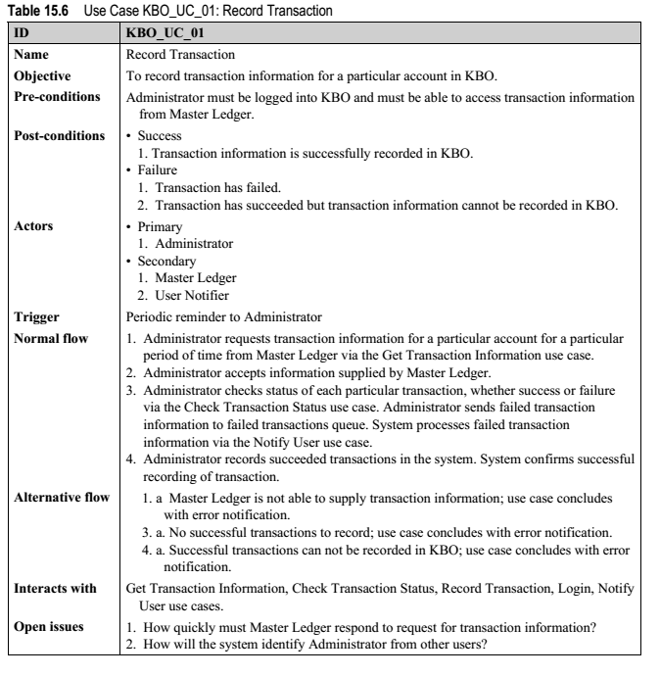

Slide 47
Use Case
General comments and notes describing the use case.
Requirements - The formal functional requirements of things that a Use Case must provide to the end user, such as <ability to update order>. These correspond to the functional specifications found in structured methodologies, and form a contract that the Use Case performs some action or provides some value to the system.

Slide 48
Use Case
Constraints - The formal rules and limitations a Use Case operates under, defining what can and cannot be done. These include:
Pre-conditions that must have already occurred or be in place before the use case is run; for example, <create order> must precede <modify order>
Post-conditions that must be true once the Use Case is complete; for example, <order is modified and consistent>
Invariants that must always be true throughout the time the Use Case operates; for example, an order must always have a customer number.

Slide 49
Use Case
Scenarios – Formal, sequential descriptions of the steps taken to carry out the use case, or the flow of events that occur during a Use Case instance. These can include multiple scenarios, to cater for exceptional circumstances and alternative processing paths. These are usually created in text and correspond to a textual representation of the Sequence Diagram.
There are recommended formats (refer to Chapter 11, Fully Dressed Use Case Template of “WRITING EFFECTIVE USE CASES”)
Scenario diagrams - Sequence diagrams to depict the workflow; similar to Scenarios but graphically portrayed.
Additional attributes, such as implementation phase, version number, complexity rating, stereotype and status.

Slide 50
Flow of Events
Basic flow of events
Is the most common pathway. It usually depicts a perfect situation, in which nothing goes wrong.
Alternative flow of events
Is a pathway that is still considered a good pathway; it’s just not the most heavily travelled one.
Exception Flow of Events
Things don’t always go as planned. An exception is an error condition that is important enough to the application to capture.

Slide 51
Cohort Exercise 4 (15 min)
Work as a group, document one use case of the App that you are developing.

Slide 52
UML 2

Slide 53
UML Diagrams
In UML 2 there are two basic categories of diagrams: structure diagrams and behavior diagrams.
The purpose of structure diagrams is to show the static structure of the system being modeled. They include the class, component, and or object diagrams. Behavioral diagrams, on the other hand, show the dynamic behavior between the objects in the system, including things like their methods, collaborations, and activities.

Slide 54
Use Case Diagrams
Definition: a diagram that shows a set of use cases and actors and their relationships.
Use case diagrams represent system functionality, the requirements of the system from the user’s respective.

Slide 55
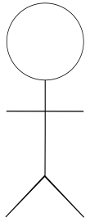
Actors
Actors are the people or systems that provide or receive information from the system; they are among the stakeholders of a system, which could be human beings, other systems, timers and clocks or hardware devices.
Actors that stimulate the system and are the initiators of events are called primary actors (active). Actors that are only receive stimuli from the system are called secondary actors (passive).

Slide 56
Who are the Actors?
Actors
Who/what will be interested in the system?
Who/what will want to change the data in the system?
Who/what will want to interface with the system?
Who/what will want information from the system?

Slide 57
Use Case in Use Case Diagrams
Use Case
Is a description of a set of sequences of actions, including variants, that system performs that yields an observable value to an actor.
Should ideally begin with a verb.
Open Account

Slide 58
Use Case Diagram: Example
Apply Course
Avoid showing communications or behaviors in use case diagram.

Slide 59
Notations: between Use Cases
include
Specifies that the source use case explicitly incorporates the behaviors of another use case at a location specified by the source
extend
Specifies that the target use case extends the behaviors of the source
<<include>>
<<extend>>

Slide 60
Use Case Diagram: Example
Login
<<include>>
Apply Course
<<extend>>
Read Course Description

Slide 61
Include and Extend
The use of include and extend is discouraged simply because they add unnecessary complexity to a Use Case diagram
Since the primary purpose of use cases is to show user centered functionality, the precedence of use cases takes little importance.

Slide 62
Granularity of Use Cases
Add
References
Manage References
Delete
References
Re-order
References
Generally, a use case should embody sufficient levels of granularity without which the use case may not be rendered as useful.

Slide 63
Cohort Exercise 5 (5 min)
Draw individually the user case diagram for KBO.

Slide 64
Sequence Diagram
A sequence diagram is an interaction diagram that highlights the order in which the messages are exchanged.
Sequence diagram complements a user case with details on the workflow of events.

Slide 65
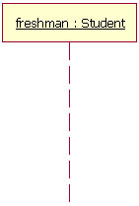
Lifelines
lifeline notation elements are placed across the top of the diagram. Lifelines represent either roles or object instances that participate in the sequence being modeled.
An object named freshman of type Student.

Slide 66
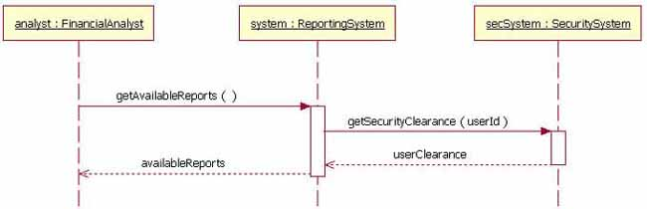
Messages
To show an object (i.e., lifeline) sending a message to another object, you draw an arrow to the receiving object.
These return messages are optional and so dotted.

Slide 67
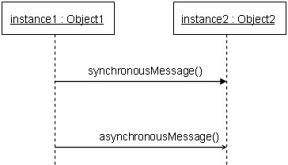
Arrows and Orders
a solid arrowhead if a synchronous call operation
a stick arrowhead if an asynchronous signal
the order of the messages is defined two rules:
On the same lifeline, a higher message precedes a lower message
Message sending precedes message receiving

Slide 68
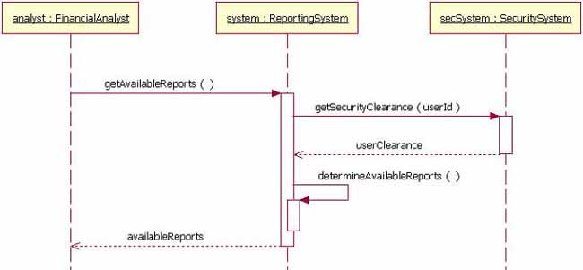
Message to Itself
An object can send a message to itself.

Slide 69
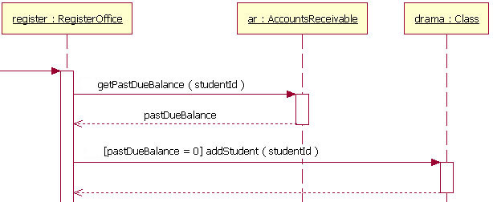
Guards

Slide 70
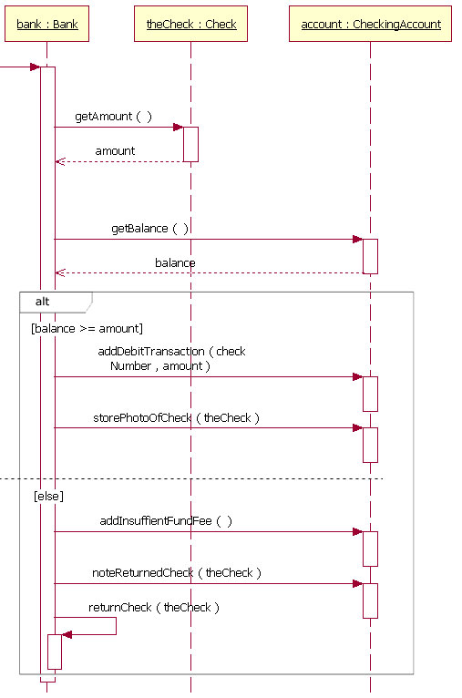
Alternatives

Slide 71
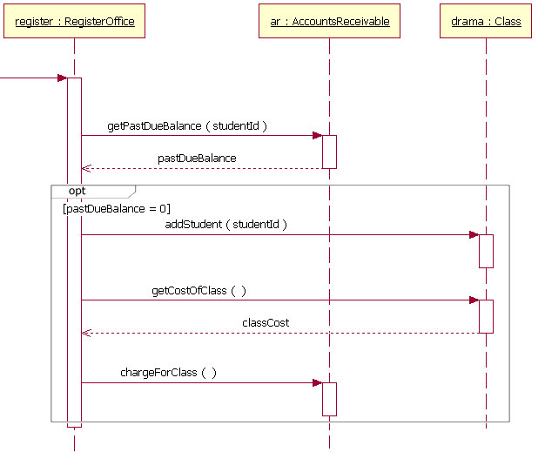
Option

Slide 72
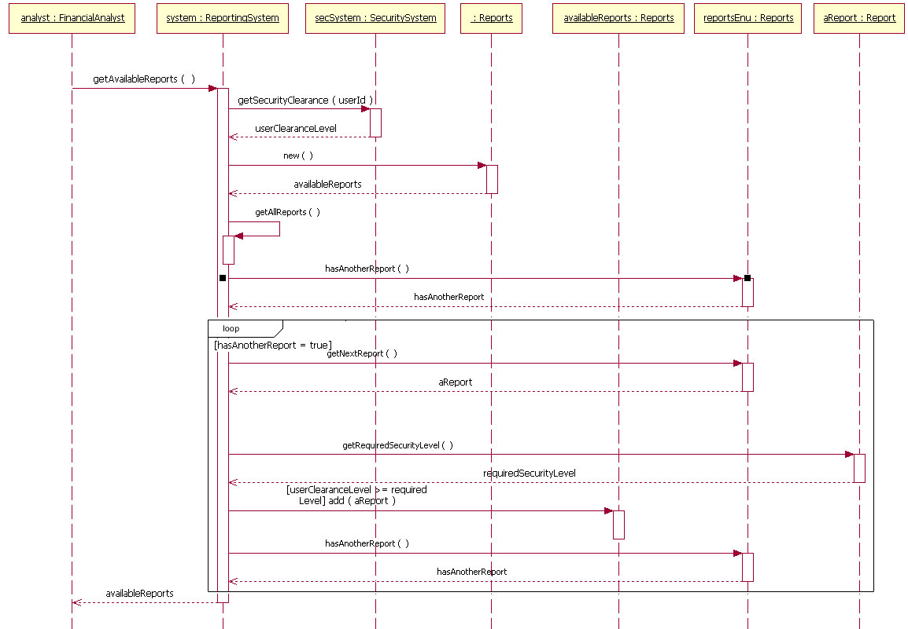
Loops

Slide 73
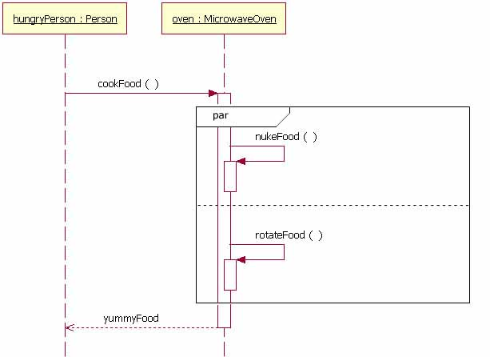
Parallel

Slide 74
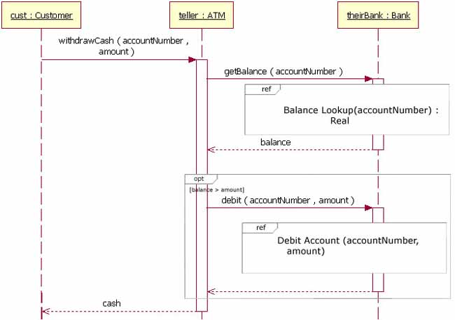
Referencing

Slide 75
Cohort Exercise 6
Draw as a group a sequence diagram for one of your use cases.

Slide 76
Class diagrams
A class diagram depicts a set of classes, interfaces, and collaborations and their relationships. Class diagrams are used most frequently while modelling object-oriented systems.

Slide 77
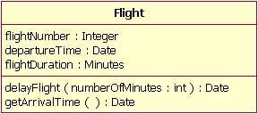
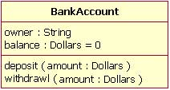
Basics
Class name
Class attribute list
Class operations list

Slide 78
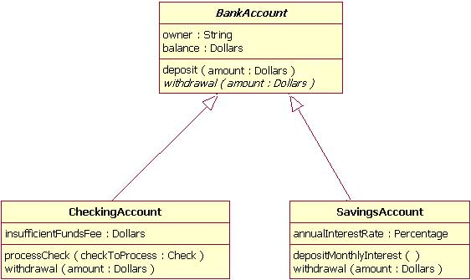
Inheritance

Slide 79
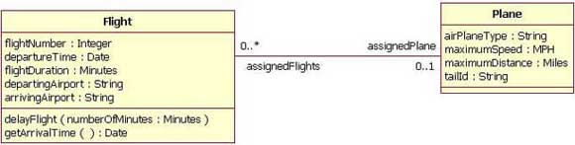
Associations
When you model a system, certain classes will be related to each other.
Bi-directional (standard) association: both classes are aware of each other and their relationship

Slide 80
Multiplicity
Indicator | Meaning
0..1 | Zero or one
1 | One only
0..* | Zero or more
* | Zero or more
1..* | One or more
3 | Three only
0..5 | Zero to Five
5..15 | Five to Fifteen

Slide 81
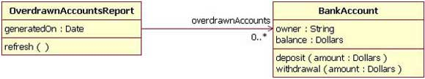
Uni-Directional Association
In a uni-directional association, two classes are related, but only one class knows that the relationship exists.

Slide 82
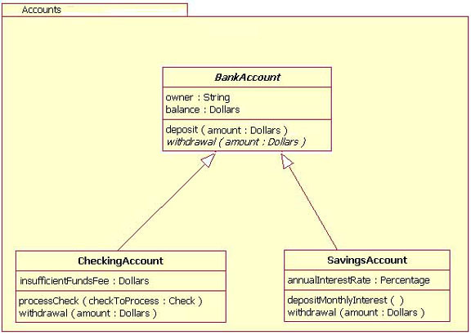
Association: Packages

Slide 83
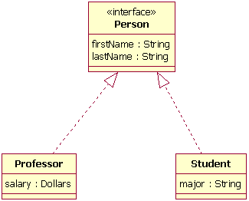
Interfaces
Dotted line indicates it’s NOT inheritance.

Slide 84
Cohort Exercise 7 (15 min)
Draw a class diagram for the following scenario. In a university there are different classrooms, offices and departments. A department has a name and it contains many offices. A person working at the university has a unique ID and can be a professor or an employee.
A professor can be a full, associate or assistant
professor and he/she is enrolled in one department.
Offices and classrooms have a number ID, and a
classroom has a number of seats.
Every employee works in an office.

Slide 85
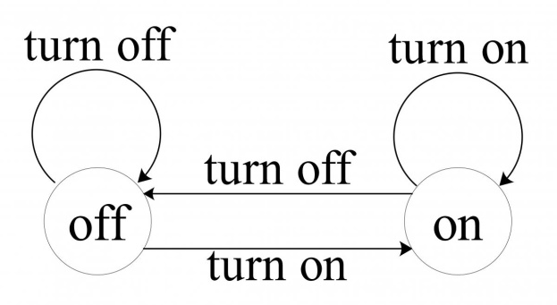
State Machine Diagrams: History
Finite state automata have a long history of being used as a modelling language.
Example: the following describes a light
Rich theoretical development based on finite state automata: Turing machine, Pushdown automata, Büchi Automata, etc.
Can we model everything using finite-state automata?

Slide 86
State Machine Diagrams
A UML state machine diagram is a behavior diagram which shows discrete behavior of a part of designed system through finite state transitions.
Describing the behavior of a class instance.
State machine diagrams can also be used to express the usage protocol of part of a system.
Protocol state machines are used to express usage protocols and can be used to specify the legal usage scenarios of classifiers, interfaces, and ports.

Slide 87
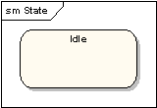
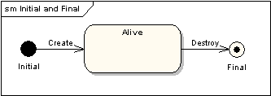
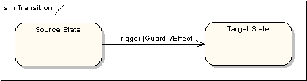
State Machine Essence
States
Initial and final states
Transitions

Slide 88
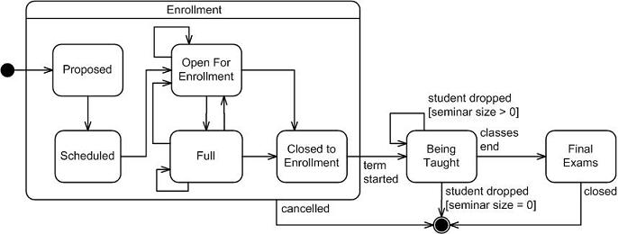
State Machine Example

Slide 89
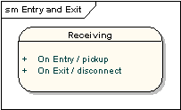
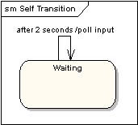
State Machine Diagrams: More
State actions
Self-looping actions

Slide 90
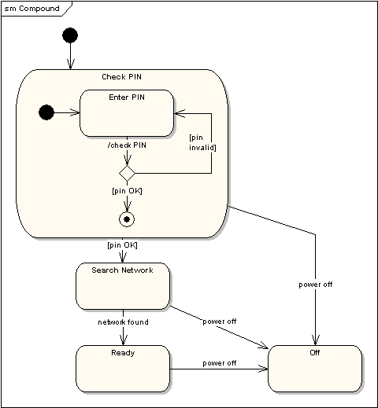
Compound states

Slide 91
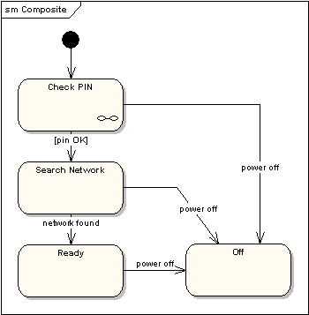
State Machine Referencing

Slide 92

Junction Pseudo State

Slide 93

History States

Slide 94

Concurrent Regions

Slide 95
Cohort Exercise 8 (10 min)
A hardware update wizard can be in three states as follows:
1. Displaying a hardware update window.
2. Searching for new hardware.
3. Displaying new hardware found.
The wizard starts by displaying a hardware update window. While displaying this window, the user can press a "Search" button to cause the wizard to start searching for new hardware, or the user can press a "Finish" button to leave the wizard. While the wizard is searching for new hardware, the user may cancel the search at any time. If the user cancels the search, the wizard displays the hardware update window again. When the wizard has completed searching for new hardware, it displays the new hardware found. Draw a state machine diagram that represents the function of the hardware update wizard just described.

Slide 96
Other UML diagrams
A set of object and their relationships are shown in an object diagram, which is a snapshot of instances of classes represented in class diagrams.
A component diagram represents an encapsulated class and its interfaces, ports, and internal structure which may consist of nested structures and connectors.

Slide 97
Other UML diagrams
An interaction diagram shows the interaction between objects or roles, via sending of messages back and forth between them.
An activity diagram is UML’s closest counterpart to the flow chart of the structural programming world; it shows the structure of a process or other computation with a step-by-step flow of control and data.
A deployment diagram represents the configuration of run-time processing nodes and components that run on them

Slide 98
UML diagrams
A package diagram depicts the decomposition of the model into organizational units and how they are dependent amongst one another.
An interaction overview diagram represents a hybrid of an activity diagram and a sequence diagram.

